Slide 1
CSE428
Milestone 1
Presentation
Istiak Ahmed (21241066)
Md Fahim Faisal (19101161)
Mahir Faisal Chowdhury (19301026)
Md Sadi Ashraf (23141067)
Sk Samiul Kadir (20101211)
Md.Waseq Alvi (20101153)

Slide 2

Dataset
Classes : Flagpole, Gondola, Glass Mask, Hourglass, Lampshades
Data Points in Train and Test Set

Slide 3
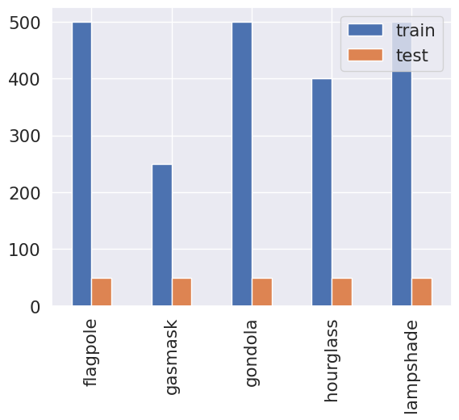
Dataset
Frequency Distribution of Classes

Slide 4
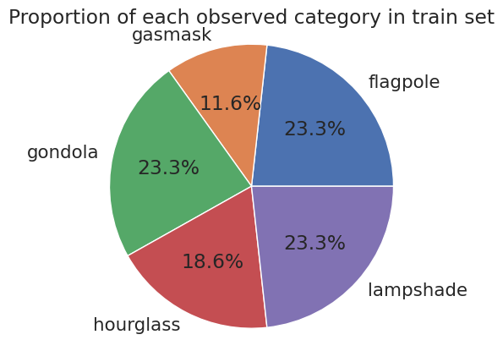
Dataset
Distribution of Data in Train Set

Slide 5
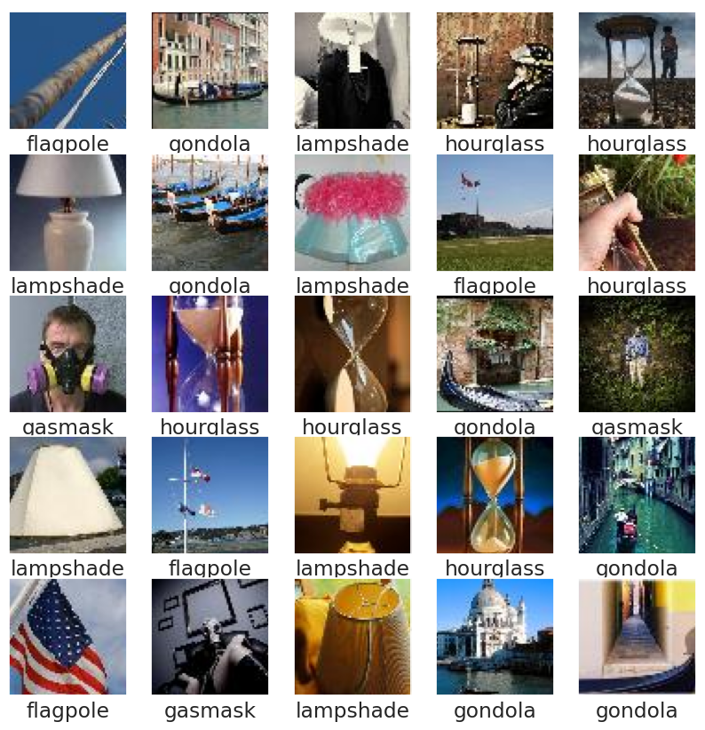
Dataset
Random 25 Images in Train Set

Slide 6
Issues with Imbalance Dataset
Biased Model Performance: Models trained on unbalanced data might become biased towards the majority class.
Poor Generalization: Unbalanced datasets can lead to poor generalization to real-world scenarios, where class distributions are likely to be more balanced.
Misclassification of Minority Class: Since there's less data for the minority class, the model might struggle to accurately identify and classify instances from minority class.
Overfitting: In the case of an unbalanced dataset, the model may overfit to the majority class, ignoring the minority class altogether.

Slide 7
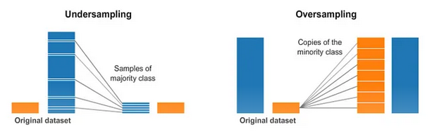
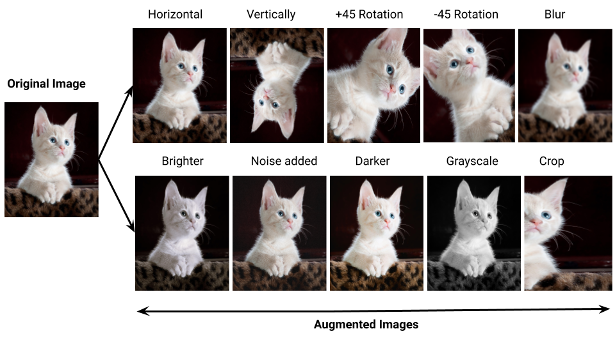
Techniques to Handle Imbalance Dataset
Resampling Techniques:
Oversampling: Increase the number of instances in the minority class by duplicating samples.
Undersampling: Reduce the number of instances in the majority class to balance the class distribution.
Data Augmentation:
Generating new training samples for the minority class by applying various transformations (Rotation, Scaling, Flipping) to the existing data.
Cost Sensitive Learning: Assigning higher costs to misclassifications of the minority class, the model can prioritize correctly classifying those samples.

Slide 8
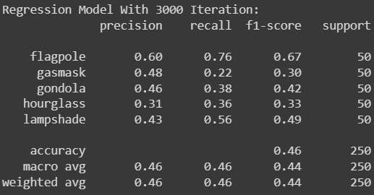
Logistic Regression Result

Slide 9
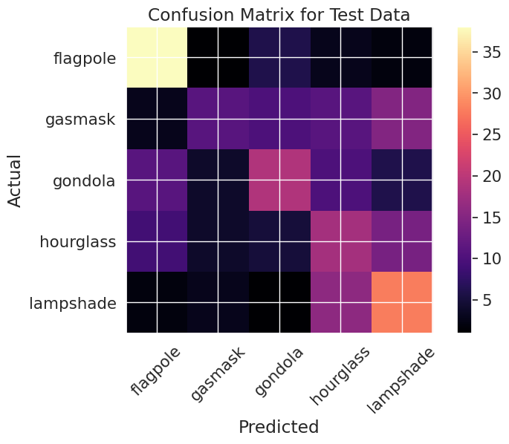
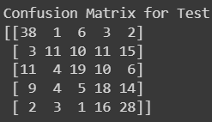
Confusion Matrix for Logistic Regression

Slide 10
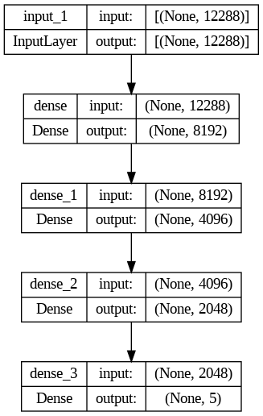
Neural Architecture

Slide 11
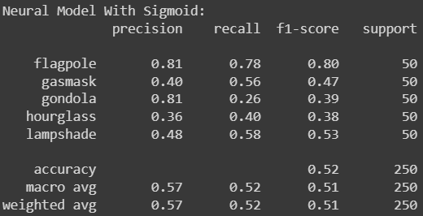
Neural Models Result

Slide 12
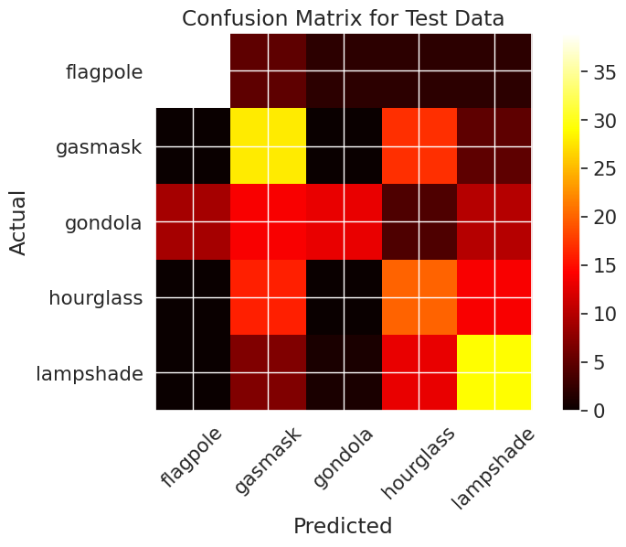
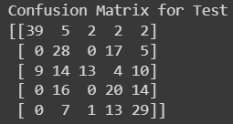
Confusion Matrix for Neural Models

Slide 13
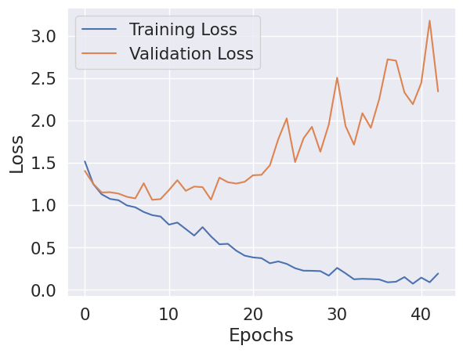
Train Vs Validation Loss

Slide 14
Results
Algorithm | Accuracy (%) | Precision (Macro) | Recall (Macro) | F Score (Macro)
Logistic Regression | 45.6 | 0.46 | 0.46 | 0.44
Neural Networks (43/200 Epochs) | 51.6 | 0.57 | 0.52 | 0.51

